Slide 1
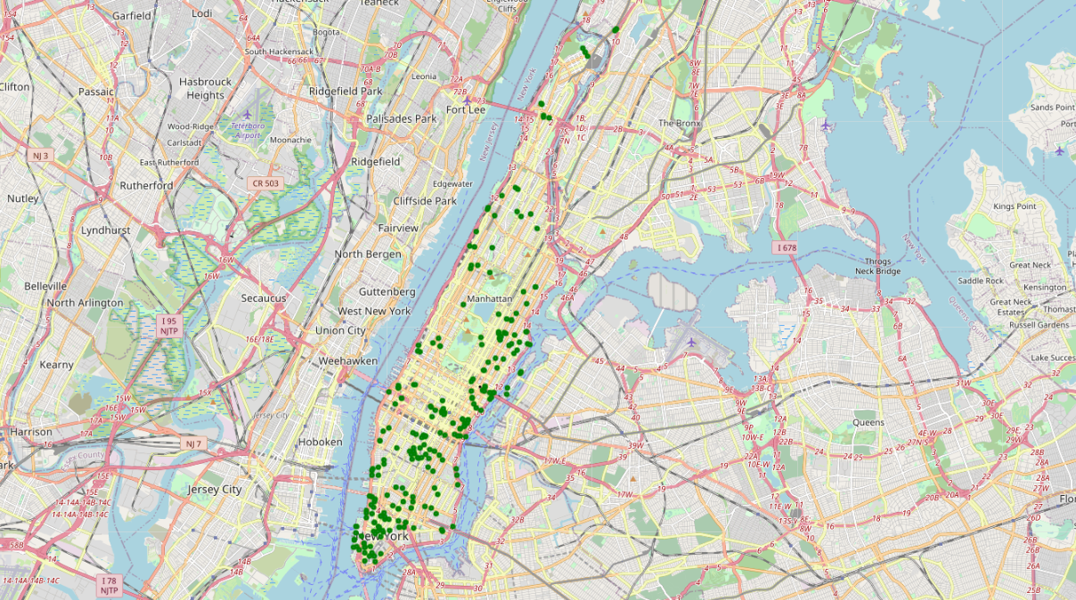
Coursera Capstone Project
Restaurant Location in NYC
Michael Iannacci
July 2020

Slide 2

Background
A group of investors is looking to invest in a new healthy choice restaurant concept
Our objective is to assist them with the process of selecting their initial location in New York City
Niche target of active people
Grab-and-go as well as sit down option
Will rely on heavy foot traffic for customers
Located near venues frequented by target consumer
Located away from venues deemed to be competitors.

Slide 3

Background
Client has selected New York City for its launch
New York City is the most populous city in the United States with an estimated 2019 population of 8,336,817 distributed over about 302.6 square miles with hundreds of thousands more commuting and travelling in each day
It is comprised of 5 boroughs and 306 neighborhoods
NYC is the ideal location to establish the first 10 locations over time before expanding throughout the region

Slide 4
Data
The following data was gathered and used in the analysis:
https://geo.nyu.edu/catalog/nyu_2451_34572
This dataset contains information, including latitude and longitude coordinates, which will allow for the boroughs and neighborhoods to be segmented and explored.
https://www.kaggle.com/adamschroeder/crimes-new-york-city
NYC crime data from www.kaggle.com
https://en.wikipedia.org/wiki/New_York_City
Miscellaneous information from Wikipedia
Foursquare API
Venue information for Manhattan

Slide 5
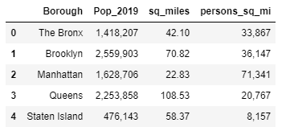
Analysis
As a first step, the demographics and crime rate were examined to determine which borough to focus on
The chart on the left shows a breakdown of the demographic data
It is obvious that from a population and density standpoint, Manhattan should be the primary focus
Manhattan provides the greatest foot traffic for and exposure of the new restaurant
In addition, Felony Crime Rates were examined for each borough
The data includes the coordinates for each incident
This tool can be used to further screen potential locations once their coordinates are known.

Slide 6

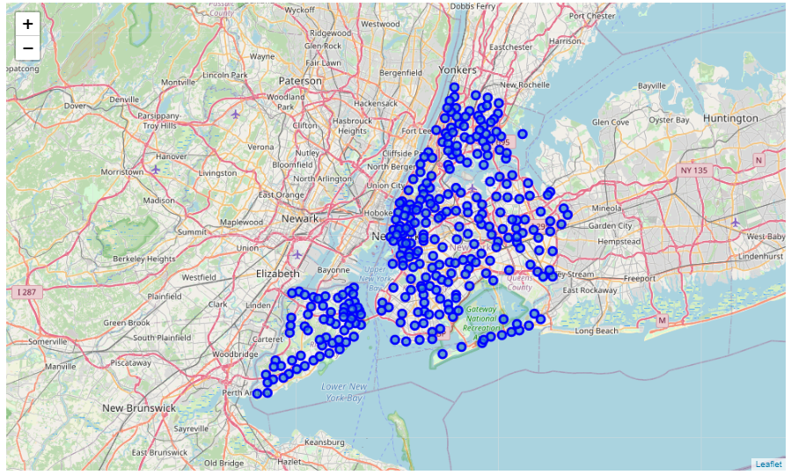
NYC Neighborhoods
Location of all 306 neighborhoods obtained from json file

Slide 7
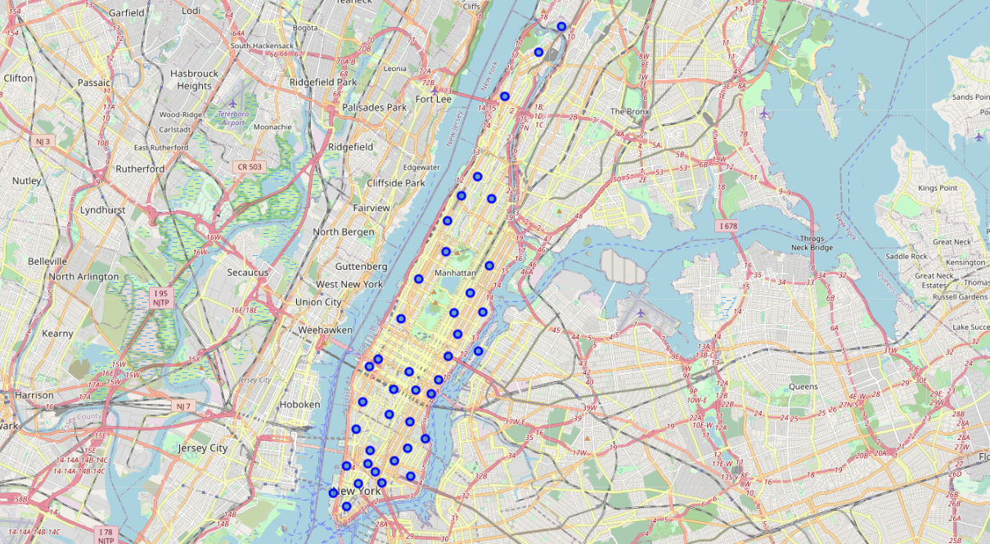
Manhattan Neighborhoods
Focus of Analysis narrowed down to Manhattan

Slide 8
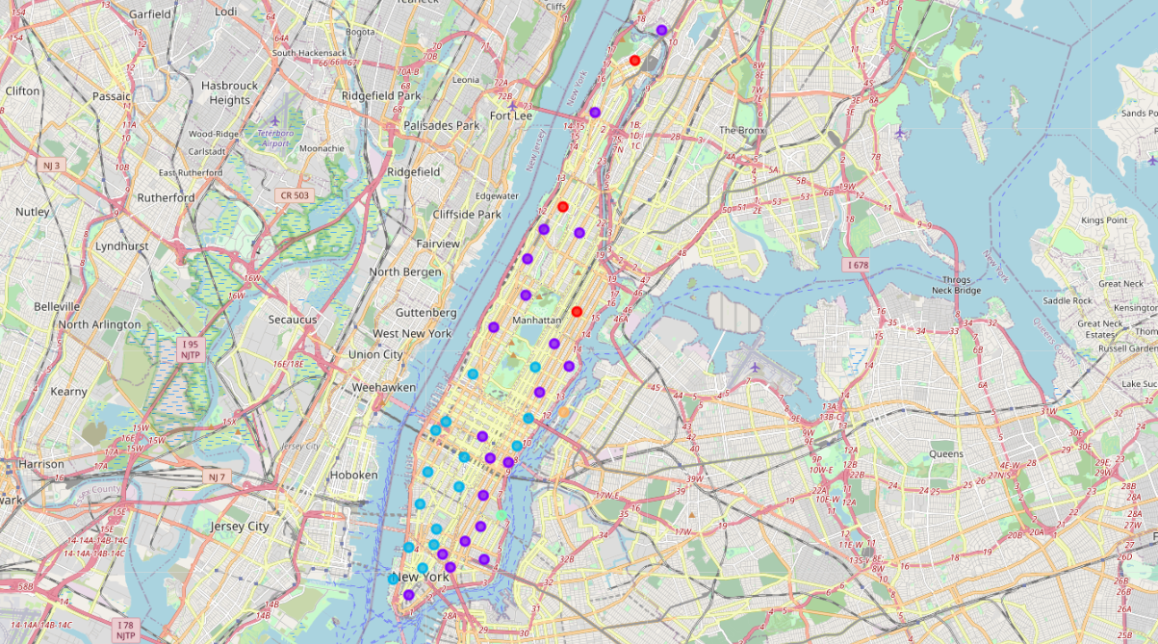
Manhattan Neighborhoods - Clustered
Clusters based on based on the mean occurrence of venue categories

Slide 9
Areas to Target and Avoid
Based on criteria provided by the client lists of venue types both target and avoid were generated
TARGET LIST
COMPETITOR LIST

Slide 10
Target Areas
Locations should be sought as centrally located to these venues as possible

Slide 11
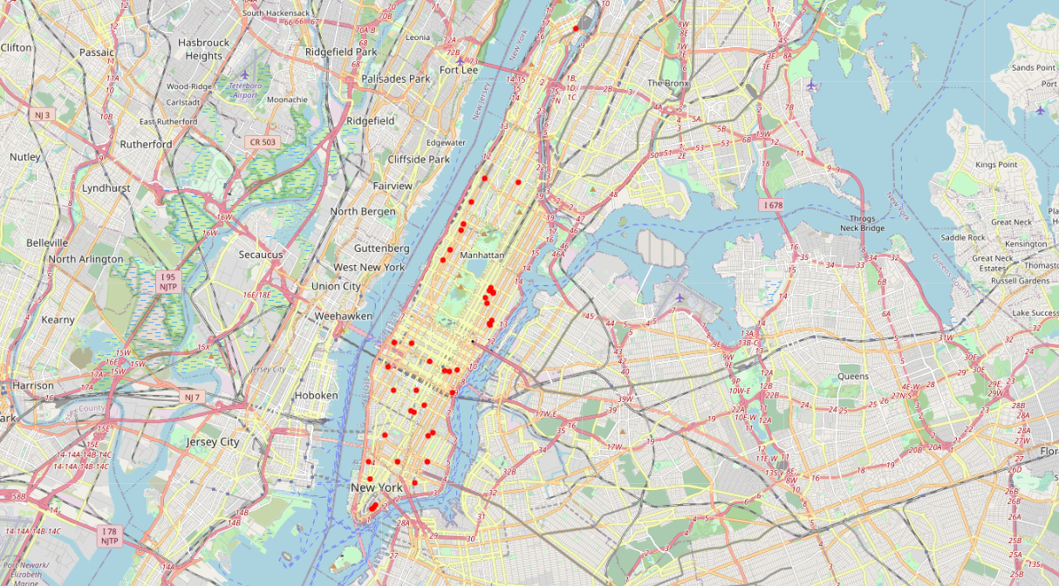
Competitor Locations
Locations should be sought as far away from these venues as possible

Slide 12
Conclusion
This analysis has provided the client with all of the tools needed to assist in the selection of their first location
The tools are also applicable to future location selection but the analysis should be updated to include the most accurate and relevant data

